Slide 1

Introduction to Tableau
By:
Sai Charan Reddy (MS in Data Science)

Slide 2
About Me:
PROFESSIONAL EXPERIENCE
Worked as a “Big Data Analyst”.
Worked as a “Data Scientist & Project Lead” New York City.
Currently working as a “Research Data Scientist Intern”.
EDUCATION
Master’s In Data Science.
Bachelor’s in Computer Science.

Slide 3
Index
How to import multiple data sets.
How to view the complete data instantly for reference on the interface.
Tableau can recognise few basic things about the data and categorises them by itself.
How to setup the map location(Country, State) in Tableau.
How to recognise and change the Unrecognised locations.
How to use edit colours option and apply colour conditions (stepped colour).
How to use advanced colour editing’s(start, end, centre) the colour that we like.
How to give and view the conditional filter scale on the tableau interface.
How to use the range, at least, at most and Special icons
How to compare different measurements with bar graphs
How to use different types of attractive graphs for comparisons.
How to use comparison graphs for high level visualisations.
How to use Box-Plot graph for finding the outliers
Creating the Dash boards with multiple sheets.

Slide 4
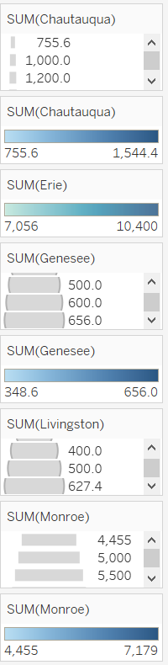
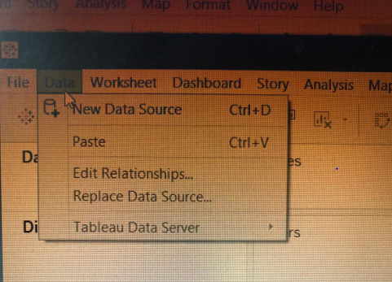
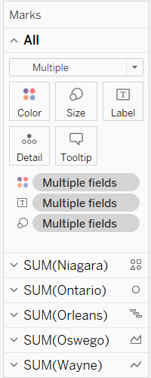
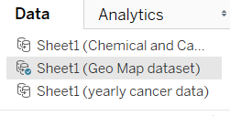
Topics for the day
How to import a data set
How to import multiple data sets

Slide 5
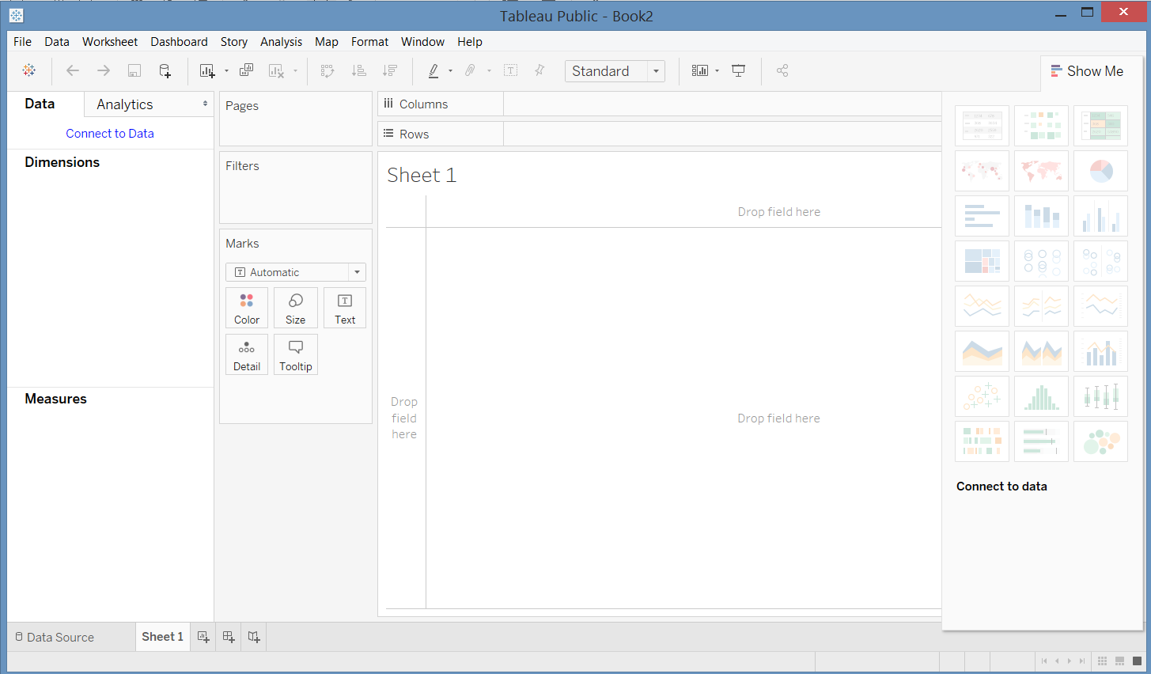

Slide 6
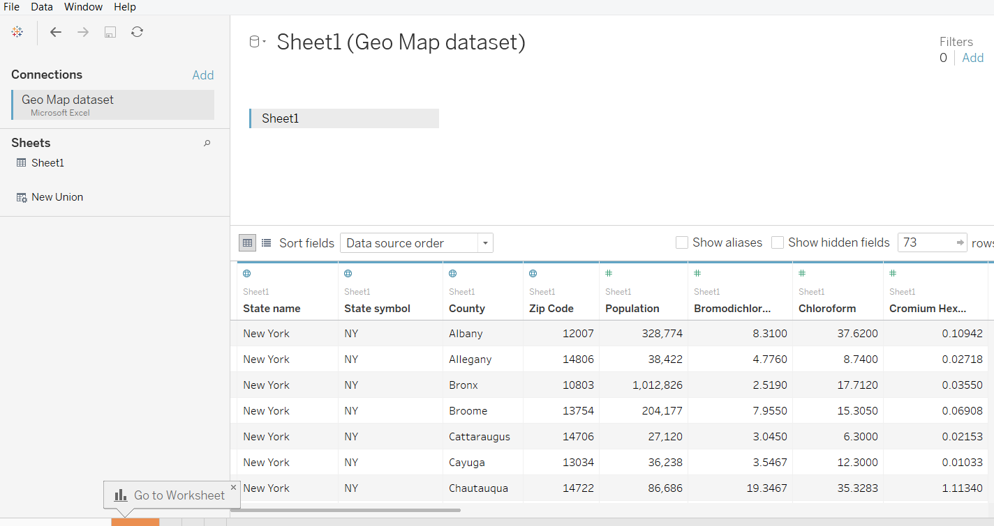
Tableau recognises the geo locations automatically
Tableau automatically recognized the Geospatial locations

Slide 7
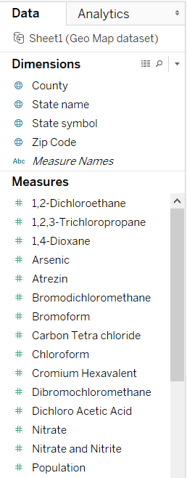
Tableau will categorises all the Columns into Dimensions and Measures automatically

Slide 8
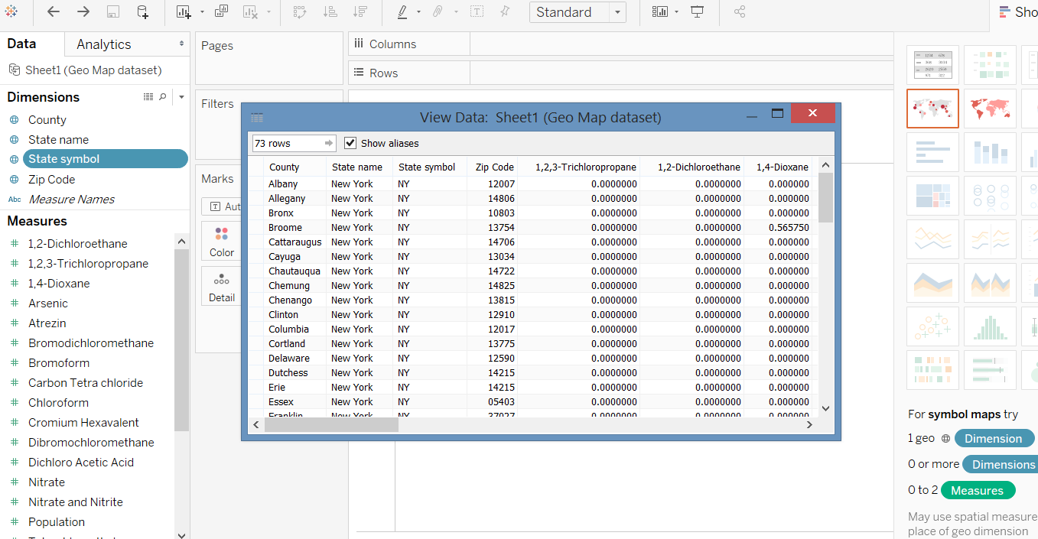
By clicking the symbol next to the Dimensions we can view the data immediately for the quick reference

Slide 9
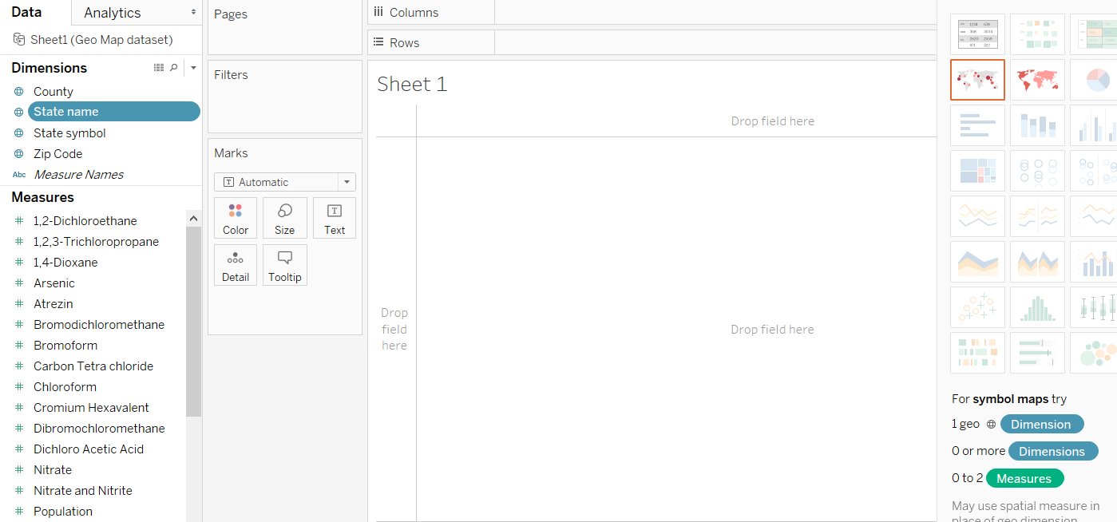
By clicking the Dimensions if you notice tableau is showing the “GEO SPATIAL GRAPH” automatically

Slide 10
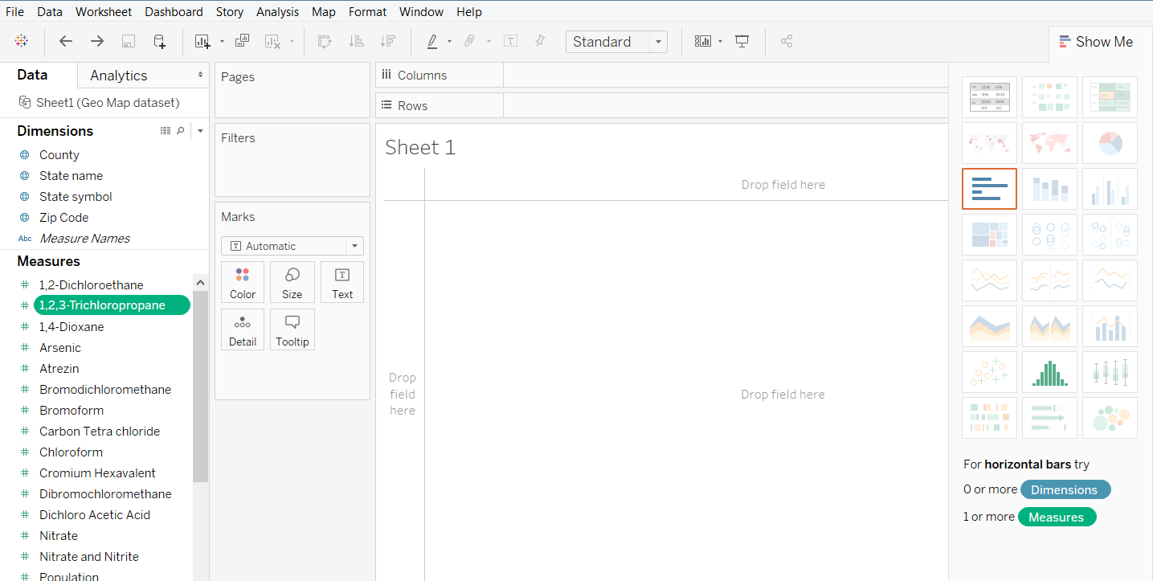
By clicking on the Measures if you notice tableau is showing the “BAR GRAPH” automatically

Slide 11
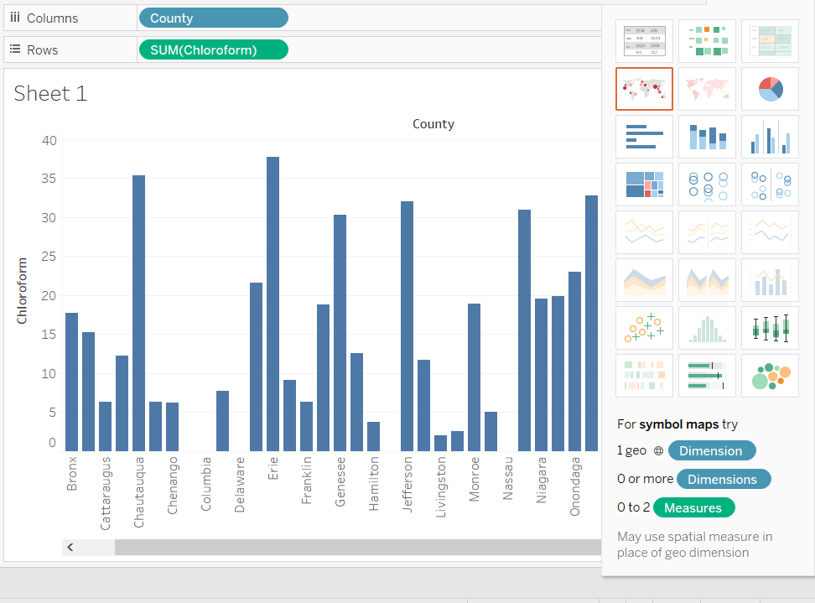
When I clicked & showing the “Bar Graph” even then tableau is still highlighting the “GEO MAP”.

Slide 12
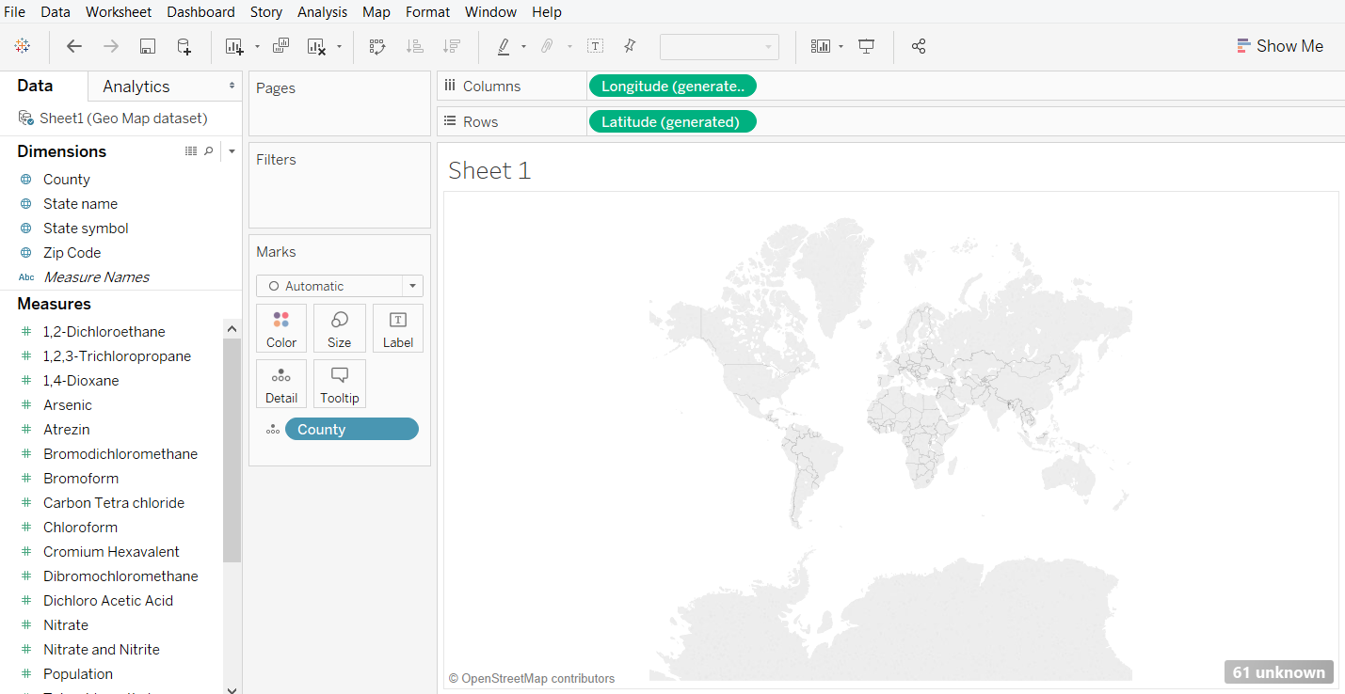
When I clicked on the “Geo map” it is showing nothing and showing 61 unknown

Slide 13
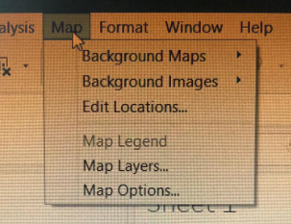
Click on the “MAP” and click on “EDIT LOCATIONS”

Slide 14
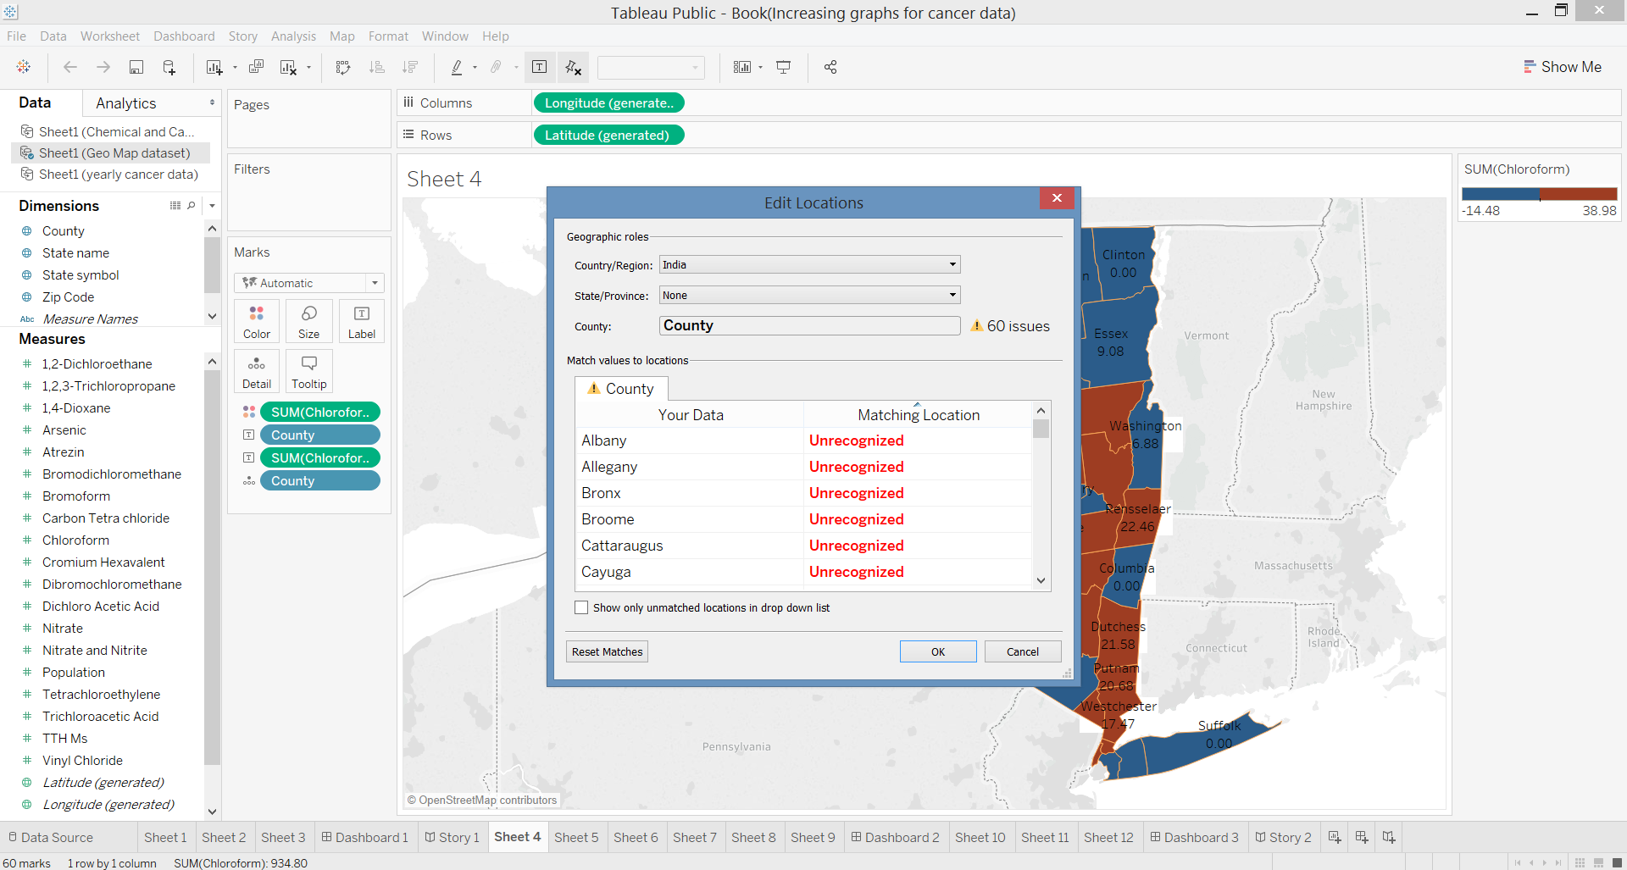

Slide 15
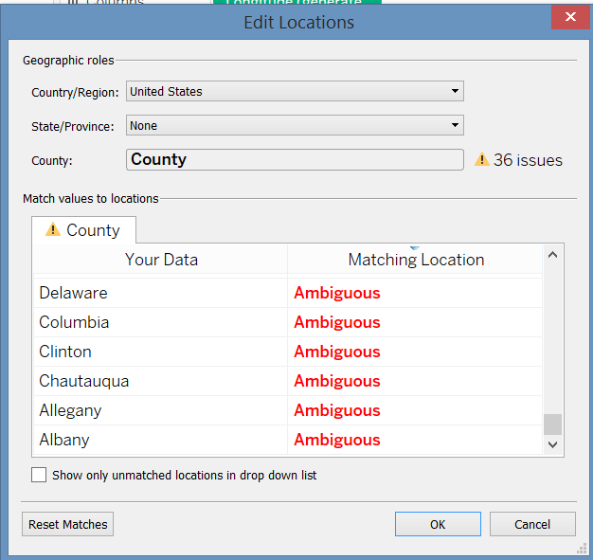
Even I have changed the country to “United States” it is showing the error “AMBIGOUS” and “36 ISSUES”. Can any one guess….?

Slide 16
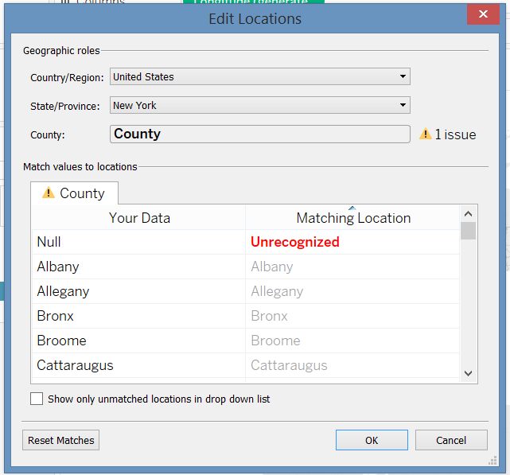
When given the state name as well it is showing only one “UNRECOGNIZED”. Which we can ignore.

Slide 17
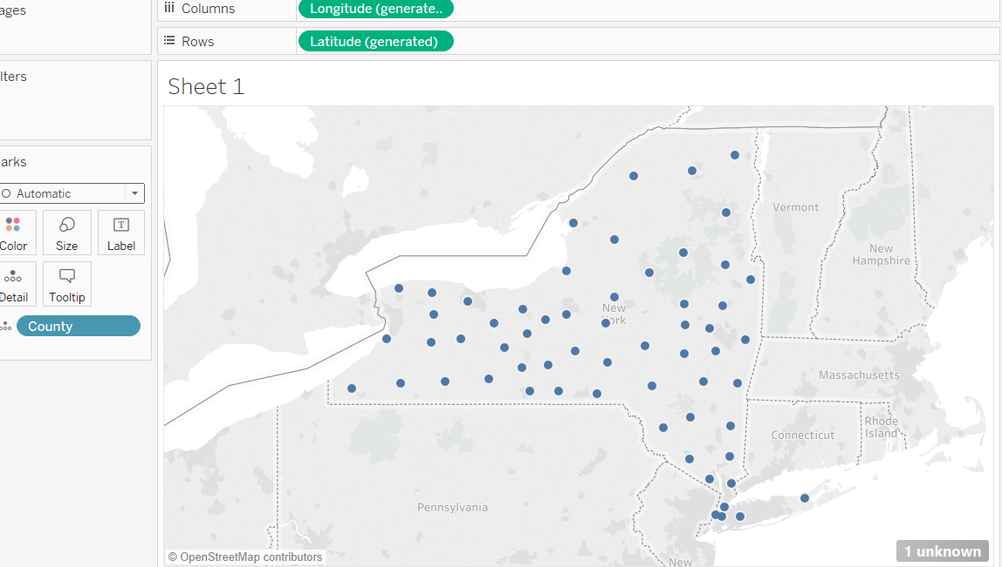
It will recognise all the counties in the New York except that null value.

Slide 18
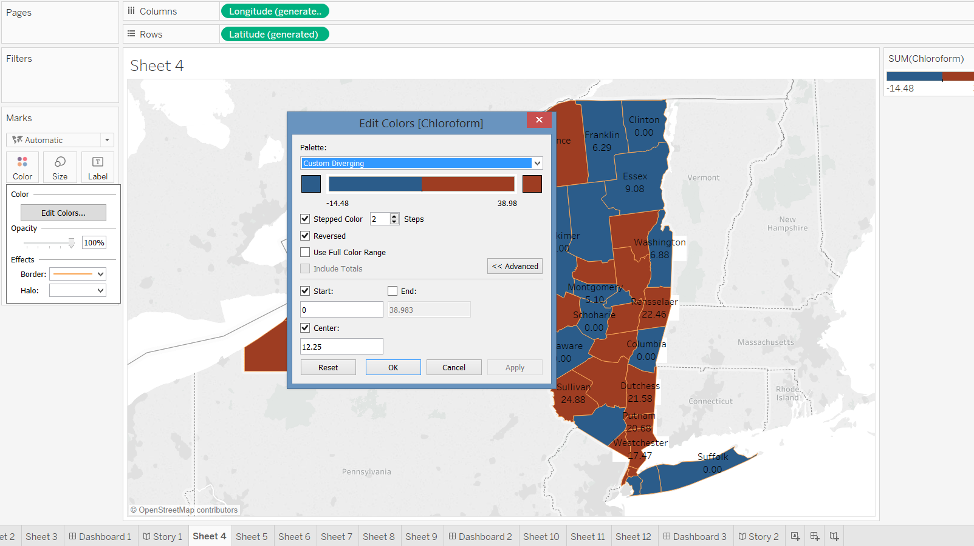
Process to edit colours and giving the conditions

Slide 19
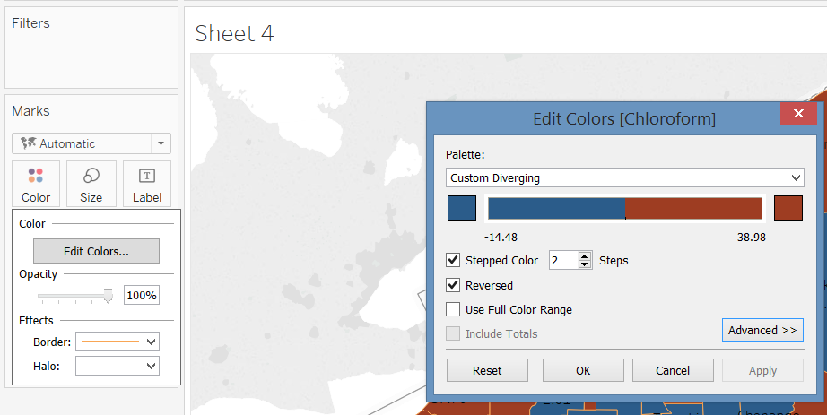
In case it is not shown .. Click the “Advanced>>>” button on the pop up window

Slide 20
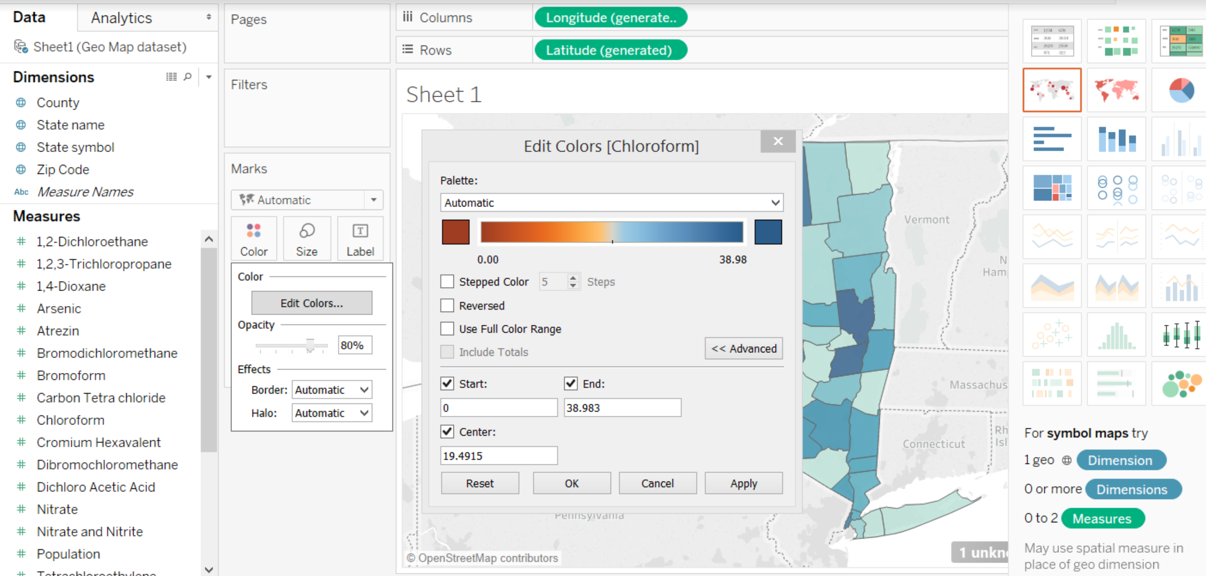
We can give conditions for the colors with “start”, “End” and “Centre” values

Slide 21
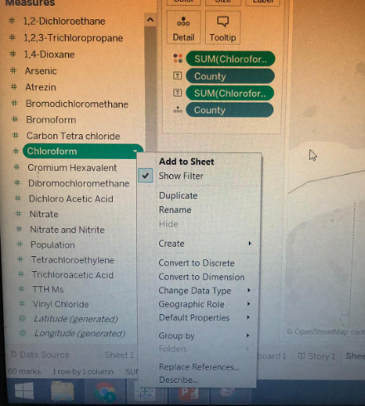
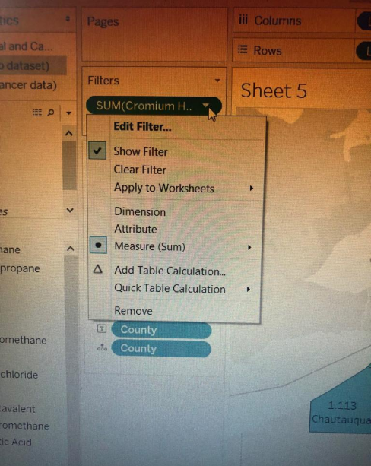
Click on the “SHOW FILTER” that will shows the filter on the right corner of the tableau

Slide 22
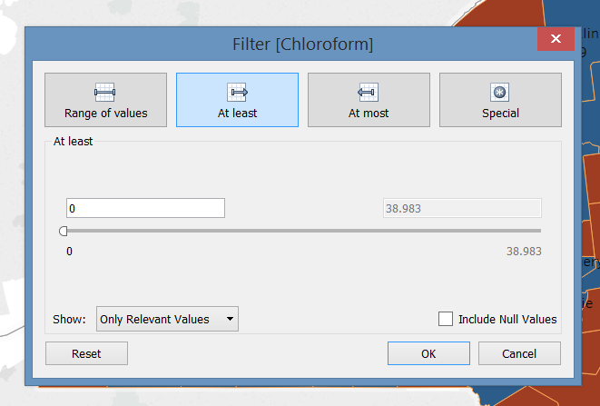
These is a “FILTER” panel. Here we can give the “Range of values” ,“at least”, “At most” and value

Slide 23
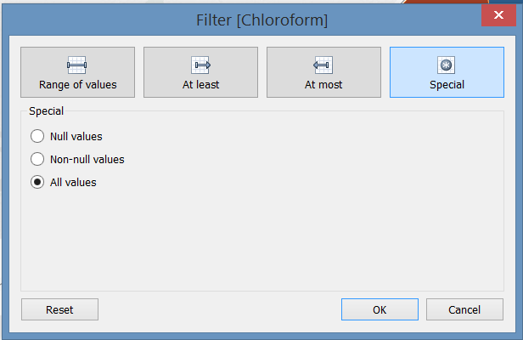
“SPECIAL button” shows the values that whether we need to select all values, non-null values and only null- values.

Slide 24
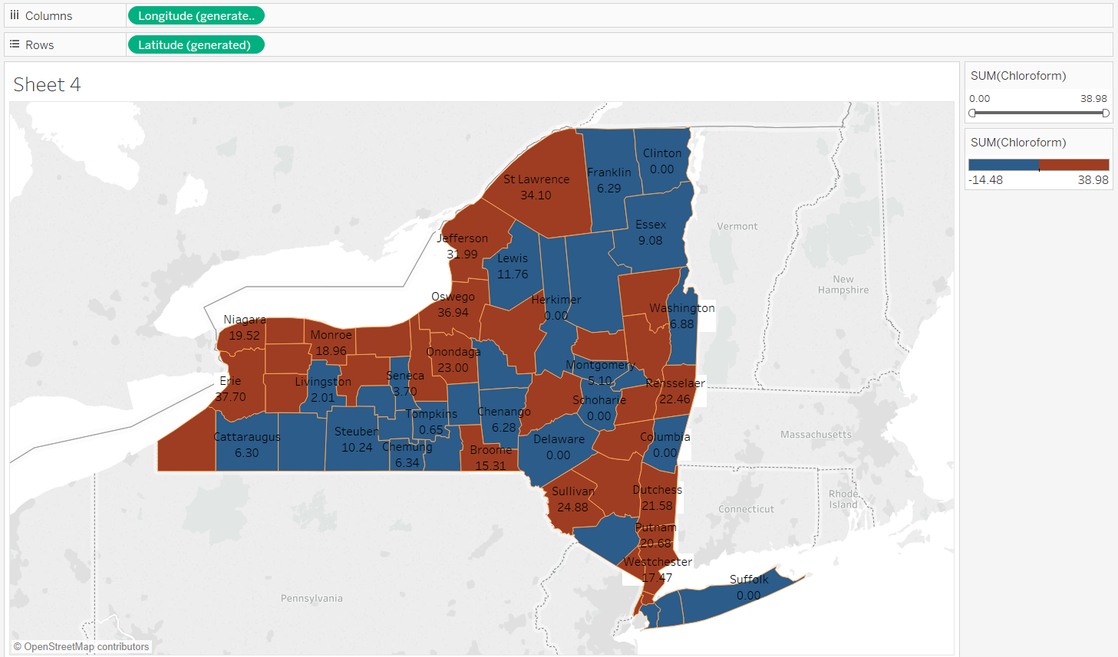
Before using the “FILTER”

Slide 25
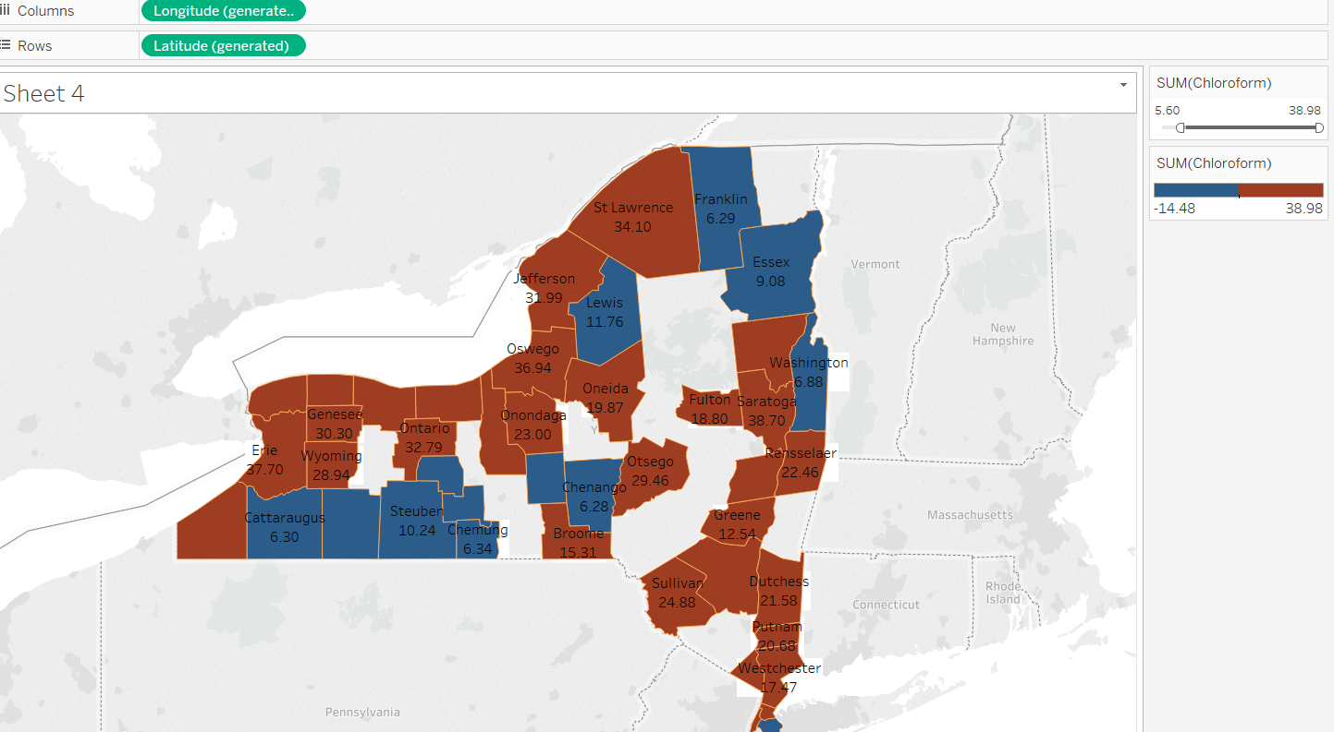
Once this done we can use this filter as we like for viewing the map

Slide 26
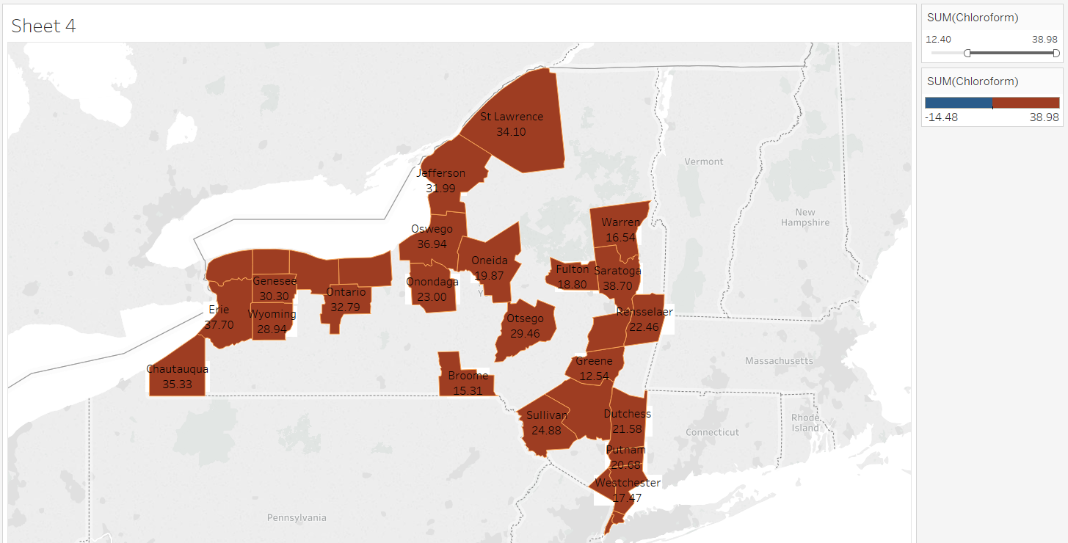
When I increased the filter to “12.40” it is showing only “red colour” not violet why…..?

Slide 27
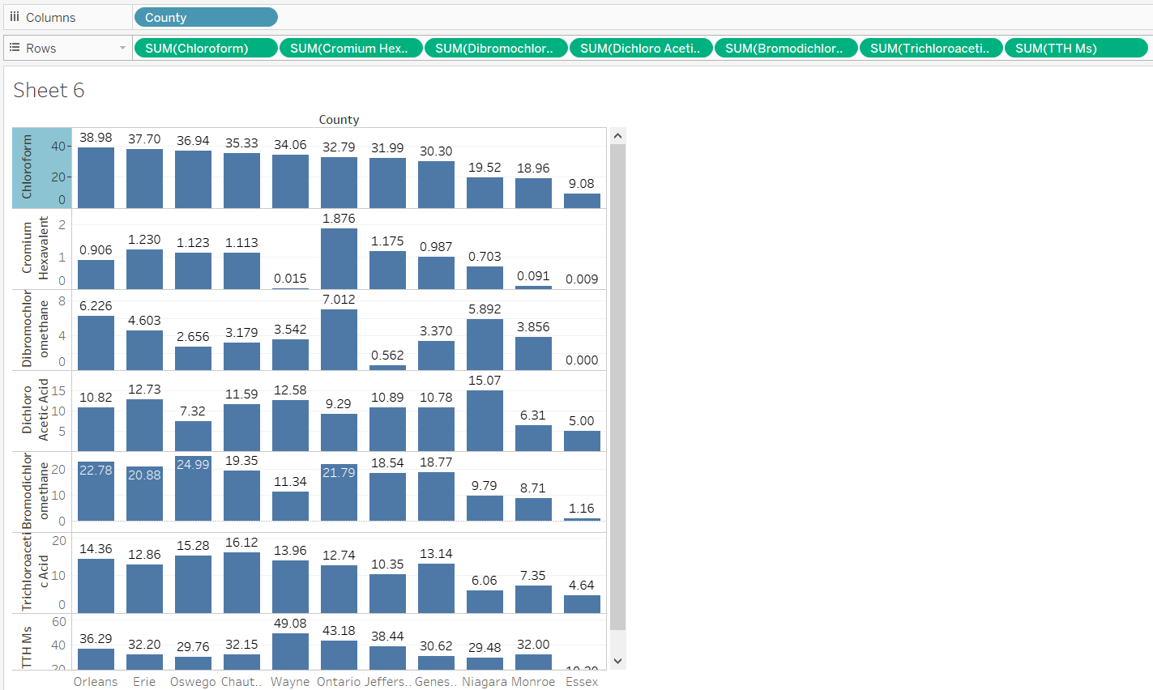
Graph where we can compare using “BAR GRAPH”

Slide 28
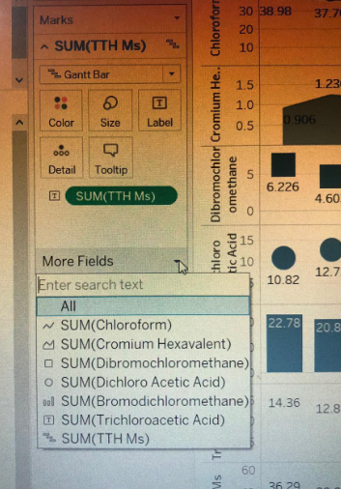
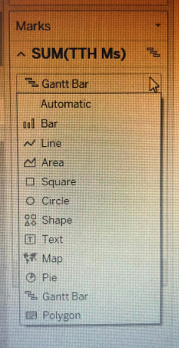
Clicking these buttons can give the different way of “graphs”

Slide 29
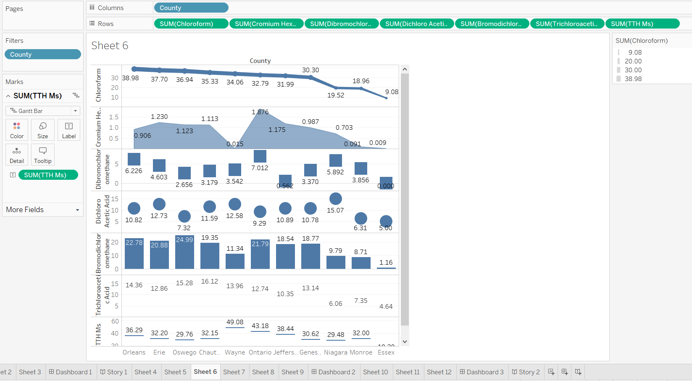
Resultant can be like this to visualize something in a best way

Slide 30
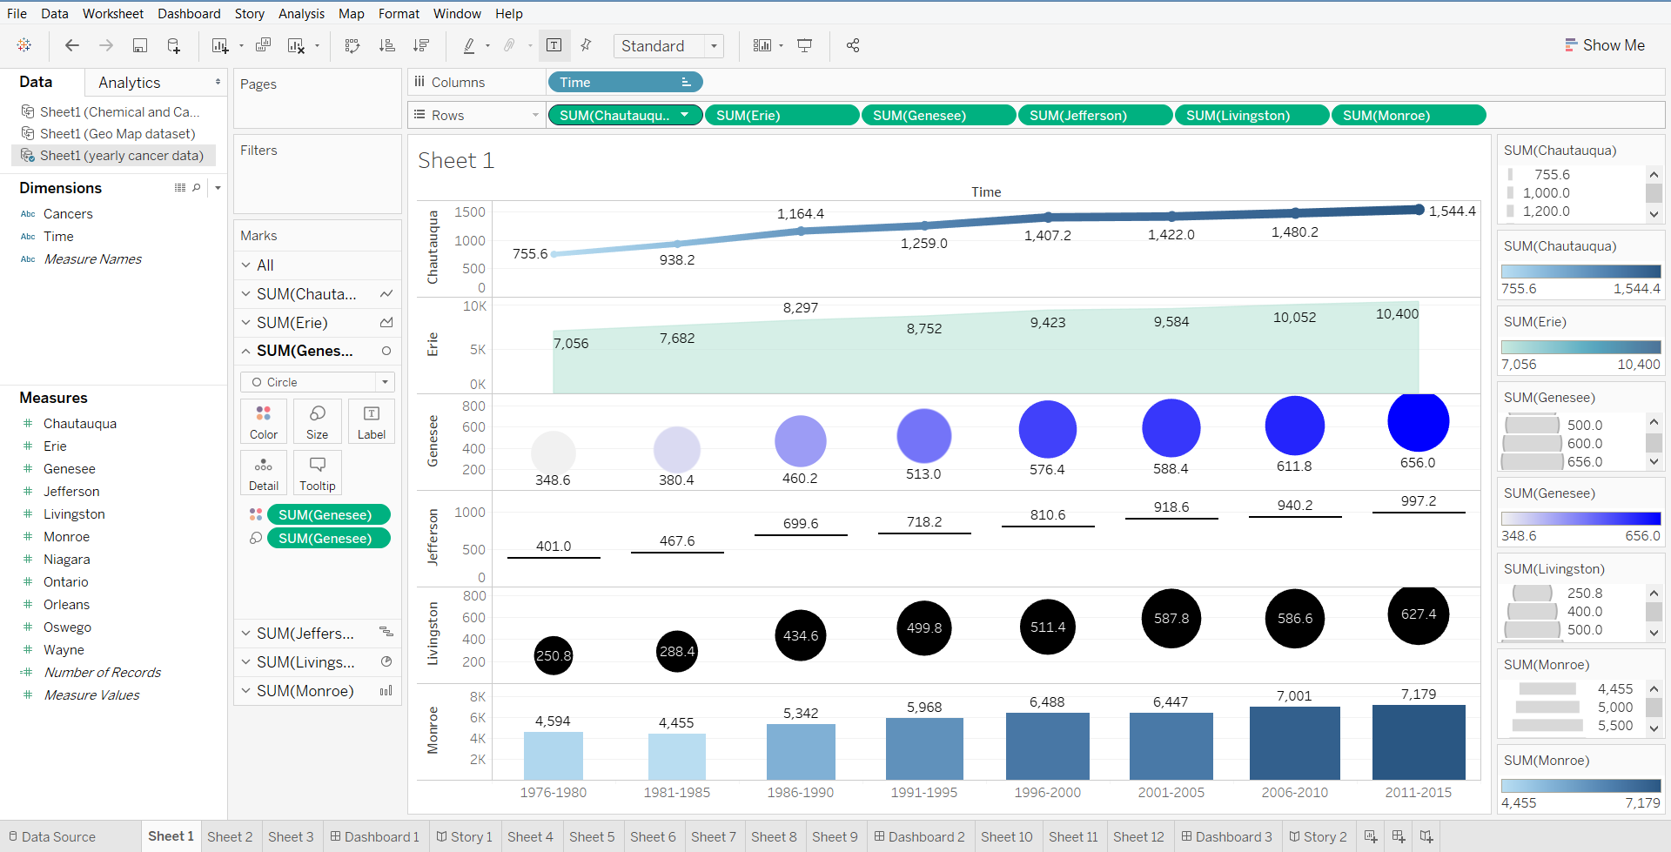
We can import multiple datasets
This is most important panel for performing filters
Where we can see all the min & max panel

Slide 31
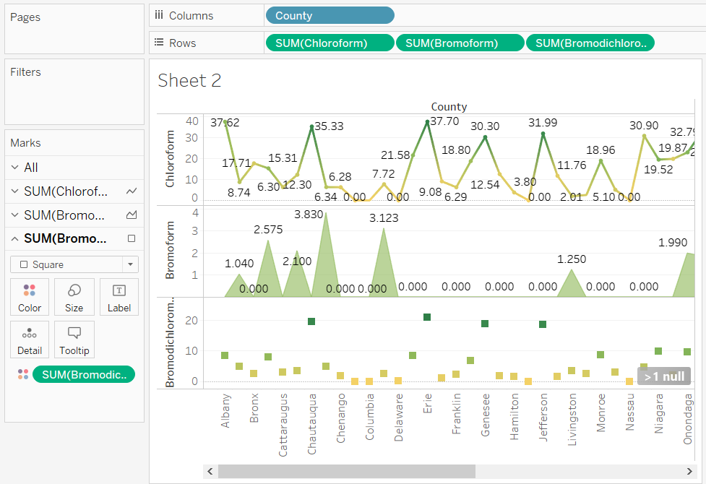
Instead of bar graphs we can be represent in other ways
Different type of graphs representations can be done

Slide 32
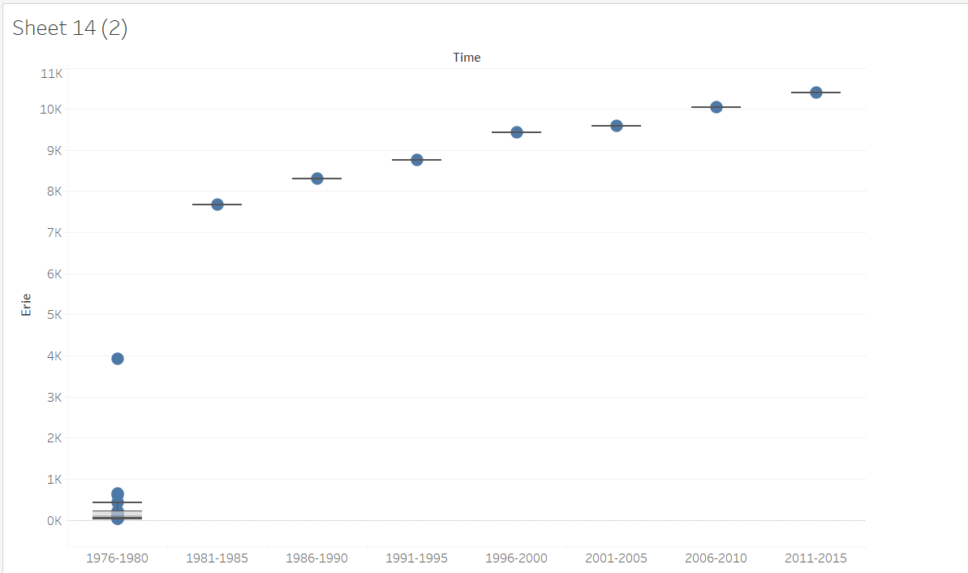
This graph shows that there are few outliers in 1976-80 but from 1981- 2015 have constant increase without . outliers

Slide 33
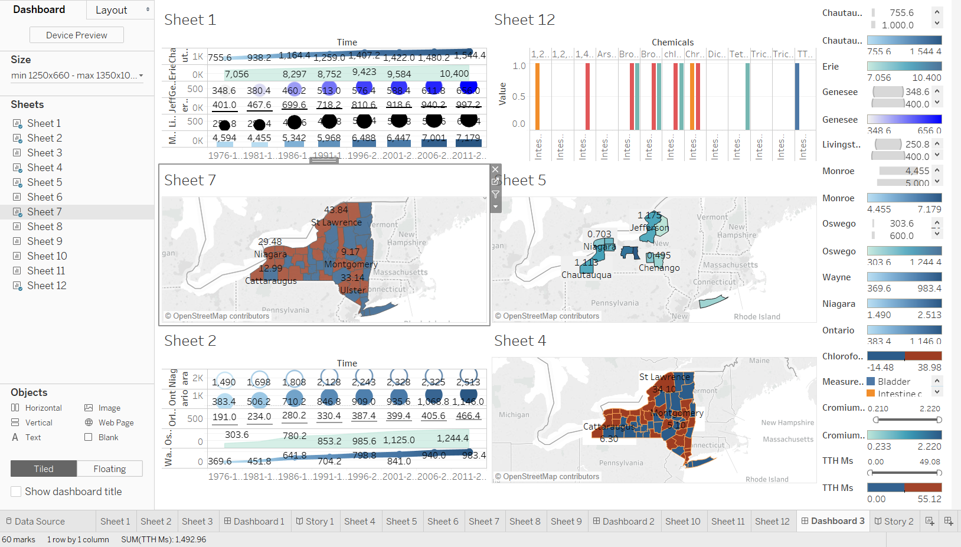
“DASHBOARDS” where we can view multiple sheets

Slide 34
Thank You

